Slide 1









Whiteboardmaths.com
7
2
1
5
© 2004 All rights reserved

Slide 2


Increase
Percentage Change
A computer accessories shop increased the price of one of its printers from £80 to £100. Find the percentage increase in price.
£80
£100
Original Price
New Price
change
In this case the change is an increase.
Percentage change =
x 100
original quantity
increase
Percentage increase =
x 100
original quantity
20
Percentage increase =
x 100 = 25%
80

Slide 3

Percentage Change
A computer accessories shop increased the price of one of its “All in one” printers from £250 to £260. Find the percentage increase in price.
£250
£260
Original Price
New Price
change
Percentage change =
x 100
original quantity
10
Percentage increase =
x 100 = 4%
250

Slide 4

Percentage Change
Find the percentage increase in price of the sideboard. (1 dp)
£490
£540
Original Price
New Price
change
Percentage change =
x 100
original quantity
50
Percentage increase =
x 100 = 10.2%
490

Slide 5
Percentage Change
ºC
The temperature readings for morning and noon at Bristol are shown on the thermometers. Calculate the percentage increase in temperature between these times.
ºC
60
60
50
50
40
40
30
30
20
20
10
10
0
10
0
Percentage increase =
x 100 = 50%
-10
20
-10
-20
-20
-30
-30
8:30
12:00

Slide 6


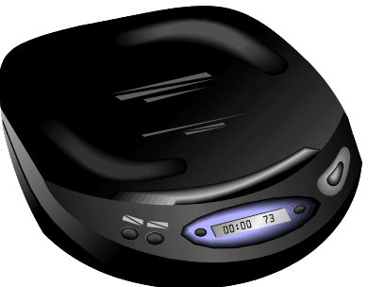


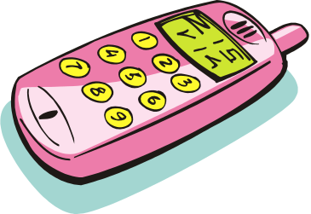
Percentage Change
The items below show the old price and new price after an increase. Calculate the percentage increase in price in each case. (1 dp)
£90
£600
£300
£98
£640
£330
8
40
30
x 100 = 8.9%
x 100 = 6.7%
x 100 = 10%
90
600
300
£20
£6.20
£44
£24
£8.10
£50
4
1.90
6
x 100 = 20%
x 100 = 30.6%
x 100 = 13.6%
20
6.20
44

Slide 7

Decrease
Percentage Change
A computer accessories shop reduced all its prices in a sale. Simon bought a printer in the sale for £90. What was the percentage decrease in price?
Sale
£90
£100
Original Price
Sale Price
change
In this case the change is a decrease.
Percentage change =
x 100
original quantity
decrease
Percentage decrease =
x 100
original quantity
10
Percentage decrease =
x 100 = 10%
100

Slide 8

Percentage Change
A computer accessories shop reduced all its prices in a sale. Jenny bought a printer at the sale price. What was her percentage saving?
Sale
£260
£200
Original Price
Sale Price
change
Percentage change =
x 100
original quantity
decrease
So Jenny made a 23.1% saving
Percentage decrease =
x 100
original quantity
60
Percentage decrease =
x 100 = 23.1%
260

Slide 9
Percentage Change
Find the percentage decrease in cost of the sideboard in the furniture sale. (1 dp)
£540
Sale
£475
Original Price
Sale Price
change
Percentage change =
x 100
original quantity
65
Percentage decrease =
x 100 = 12.0%
540

Slide 10

Percentage Change
Find the percentage decrease in the cost of the car in the sale. (1 dp)
Sale
£34000
£35500
Original Price
Sale Price
change
Percentage change =
x 100
original quantity
1500
Percentage decrease =
x 100 = 4.2%
35 500

Slide 11
Percentage Change
ºC
The temperature readings for the times shown in Cairo are displayed on the thermometers. Calculate the percentage decrease in temperature between these times.
ºC
60
60
50
50
40
40
30
30
20
20
10
10
0
10
0
Percentage decrease =
x 100 = 25%
-10
40
-10
-20
-20
-30
-30
1200
0200

Slide 12
Percentage Change
Sale
Calculate the percentage decrease in prices for each of the items shown in the sale. (I dp)
£105
£700
£350
£85
£620
£330
20
80
20
x 100 = 19.0%
x 100 = 11.4%
x 100 = 5.7%
105
700
350
£20
£10.00
£54
£18
£8.10
£48
2
1.90
6
x 100 = 10%
x 100 = 19%
x 100 = 11.1%
20
10.00
54

Slide 13

Population change
The table below shows the populations of 5 countries in both 1950 and 1980 (in millions). Calculate the percentage increase/decrease in each case. (1 dp)
 | 1950 | 1980 | % increase/decrease
A | 13.7 | 14.2
B | 9.6 | 9 .1
C | 47.8 | 55.6
D | 24.6 | 22.4
E | 5.7 | 7.5
3.6% increase
5.2% decrease
16.3% increase
8.9% decrease
31.6% increase

Slide 14
Worksheet1
Percentage Change
The items below show the old price and new price after an increase. Calculate the percentage increase in price in each case. (1 dp)
£90
£600
£300
£98
£640
£330
£20
£6.20
£44
£24
£8.10
£50

Slide 15
Worksheet 2
Percentage Change
Sale
Calculate the percentage decrease in prices for each of the items shown in the sale. (I dp)
£105
£700
£350
£85
£620
£330
£20
£10.00
£54
£18
£8.10
£48

